Slide 1
Cell Biology Lec (12)
Cell Respiration

Slide 2
Cell Respiration
Energy flows into an ecosystem as sunlight and leaves as heat.
Photosynthesis generates O₂ and organic molecules, which are used in cellular respiration.
Cells use chemical energy stored in organic molecules to regenerate ATP, which powers work.
The most efficient way for cells to harvest energy stored in food is through cellular respiration, a catabolic pathway for the production of adenosine triphosphate (ATP).

Slide 3

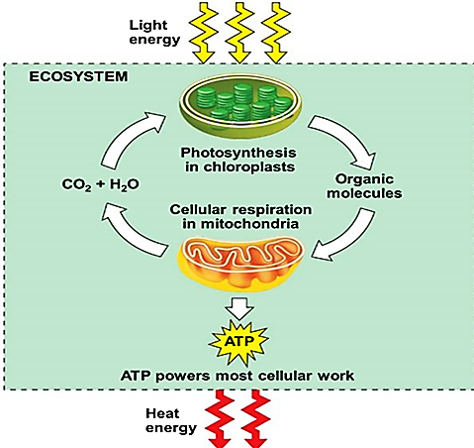

Slide 4
Cell Respiration
Cell Respiration : Cellular respiration is the process by which glucose (C6H12O6) is broken down to release energy for making ATP, another form of chemical energy.
Types of cell respiration
There are two types of cell respiration:
aerobic cell respiration, a reaction with participation of molecular oxygen (O2).
anaerobic cell respiration, without participation of molecular oxygen but with other inorganic molecules as oxidant. There are several varieties of anaerobic cell respiration, the main one is fermentation.

Slide 5

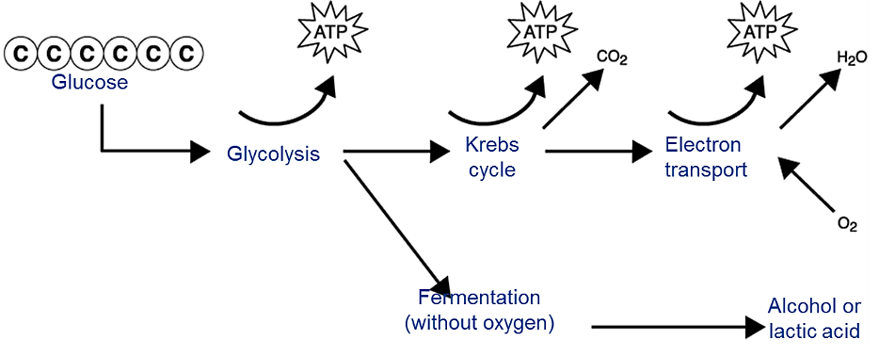

Slide 6
Aerobic Cellular respiration
There are three stages of Cellular respiration:
Glycolysis (occurs in the cytosol)
Krebs cycle or the Citric Acid Cycle (takes place in the matrix of the mitochondria)
Electron Transport Chain (takes place in the inner mitochondrial membrane).

Slide 7
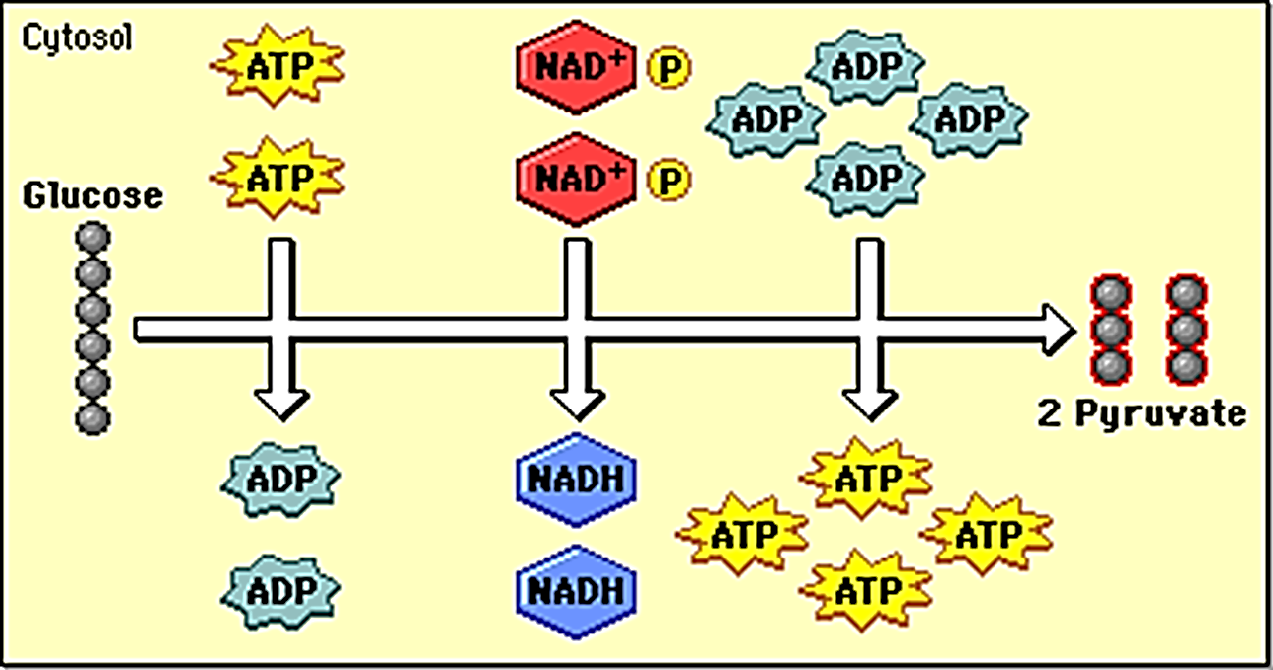
Glycolysis
Glycolysis: is the first phase of respiration where glucose is broken down with a small energy yield. This process takes place in the cell cytoplasm.
A 6-carbon glucose molecule is split up and changed into two molecules of a 3-carbon substance called pyruvic acid.
Two ATPs are produced.
Two "high energy" electron carrying molecules of NADH are produced.

Slide 8
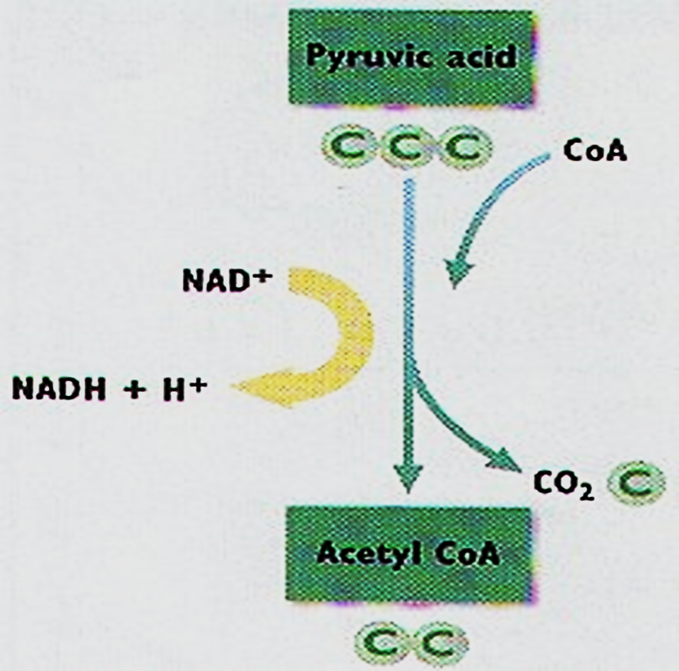
Krebs cycle
The Krebs cycle: occurs in the mitochondrial matrix and generates a pool of chemical energy (ATP, NADH, and FADH2) from the oxidation of pyruvate.
Pyruvate is transported into the mitochondria and loses carbon dioxide to form acetyl-CoA, a 2-carbon molecule.

Slide 9
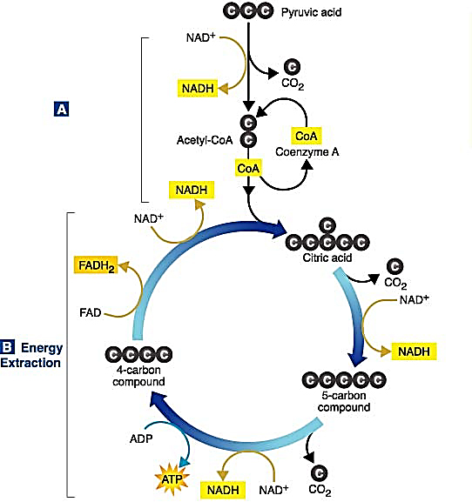
When acetyl-CoA is oxidized to carbon dioxide in the Krebs cycle, chemical energy is released and captured in the form of NADH, FADH2, and ATP.

Slide 10
Electron Transport Chain
Electron Transport Chain: allows the release of the large amount of chemical energy stored in NADH and FADH₂. The energy released is captured in the form of ATP (3 ATP per NADH and 2 ATP per FADH2). Cytochromes are proteins of the internal mitochondrial membrane that are specialized in electron transfer and participate in the respiratory chain.
NADH + H+ + 3 ADP + 3 Pi + 1/2 O2 → NAD+ + H2O +
3 ATP
FADH2 + 2 ADP + 2 Pi + 1/2 O2 → FAD+ + H2O + 2 ATP

Slide 11
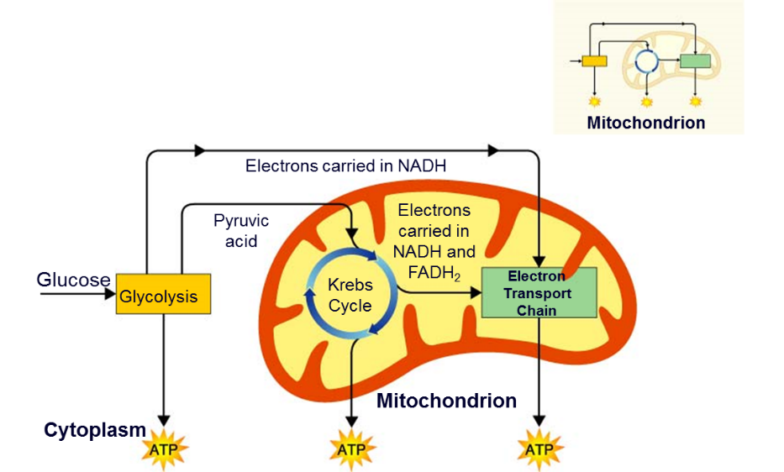


Slide 12
Fermentation
Occurs only when there is not sufficient oxygen available to permit aerobic reactions.
There are two common types of fermentation:
lactic acid fermentation
Alcohol fermentation
In lactic acid fermentation:

Slide 13
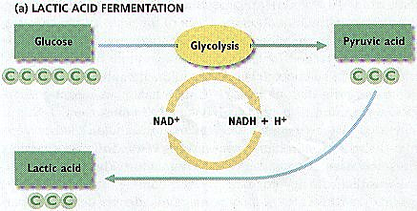

Slide 14
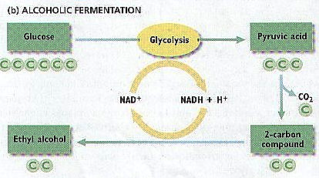

In alcohol fermentation:

Slide 15
Compares between aerobic and anaerobic respiration
Aerobic respiration | Anaerobic respiration
1. Takes place in the presence of free oxygen. | 1. Takes place in the absence of free oxygen.
2. The first step of this process (glycolysis) takes place in cytoplasm while the second step (Krebs cycle) is carried out in mitochondria. | 2. The complete process is carried out in the cytoplasm.
3. Glucose is completely oxidized into carbon dioxide and water. | 3. Glucose is incompletely oxidized into carbon dioxide and ethyl alcohol.
4. 36 molecules of ATP are produced by the complete oxidation of one gram-mole of glucose. | 4. Only 2 molecules of ATP are formed in this process.

